Slide 1

Cyber Defense in Action: Threat Detection, Infrastructure Security, and OpenSSL
Week 4 presentation
Intern: Assil Bzal

Slide 2
Outline
Introduction
Core networking concepts
Common network attacks
Defensive tools and infrastructure Security
Enterprise threats
Human Factor threats
Organizational Security Practices
Industry Regulations & Certifications
Cloud & Enterprise Security
Anonymity, Attribution & Advanced Threats
Critical Infrastructure & National Security
Mobile Security
IoT Security
Advanced Defensive Techniques

Slide 3
Real-time cybersecurity (intro)
Imagine your house has a security camera. If someone tries to break in, you don’t want to know tomorrow, you want to know right now. That’s what real-time cybersecurity is: spotting and stopping digital thieves as they attack.

Slide 4
TCP/IP
Evolution: Long ago, the internet was like a small neighborhood with only a few houses. Communication was simple. But as the neighborhood grew into a global city, we needed new ways to deliver letters safely, that’s how TCP/IP evolved.
Overview: TCP/IP is the mailman of the internet. TCP makes sure the letter is complete, and IP makes sure it goes to the right address.
3-way-handshake: Think of two people greeting each other with a handshake:
Person A: ‘Hello, are you there?’ (SYN)
Person B: ‘Yes, I’m here. Hello back.’ (SYN-ACK)
Person A: ‘Great, let’s talk.’ (ACK) That’s how computers start talking!

Slide 5
FTP (file transfer protocol)
A standard way for computers to send and receive files.
Uses a client (you) and a server (the destination).
Runs mainly on two ports:
Port 21 → the control channel (instructions: login, start, stop).
Port 20 (or dynamic) → the data channel (actual files moving).
Design Principles for FTP Firewall Rules
Allow only trusted IPs to use FTP.
Restrict ports → open just the ones needed (not the whole range).
Use secure versions (SFTP/FTPS) instead of plain FTP.
Log activity → track who uploads/downloads what.

Slide 6
TCP sequence number attack
When two computers talk using TCP, they use sequence numbers to keep track of data.
Example:
Computer A sends data with sequence number 100.
Computer B replies, “Got it, now send me 101.”
This keeps the conversation in order, just like page numbers.
The Attack:
If a hacker can predict the next sequence number, they can send fake data packets that look like they came from the trusted computer.
The victim accepts these packets because the sequence number fits into the conversation.

Slide 7
Why it dangerous and how to solve it?
Why is this Dangerous?
The attacker can inject fake commands (e.g., telling a server to transfer money or open access).
It’s a form of session hijacking — the attacker takes over the conversation.
Since the attacker fakes the source IP (like writing your friend’s name on the note), the victim doesn’t even know it’s not really their friend.
🔐 How Do We Defend Against It?
Use randomized sequence numbers so attackers can’t guess them.
Encrypt communications (TLS/SSL) so even if they guess, they can’t craft the right content.
Monitor for suspicious traffic (intrusion detection systems).

Slide 8
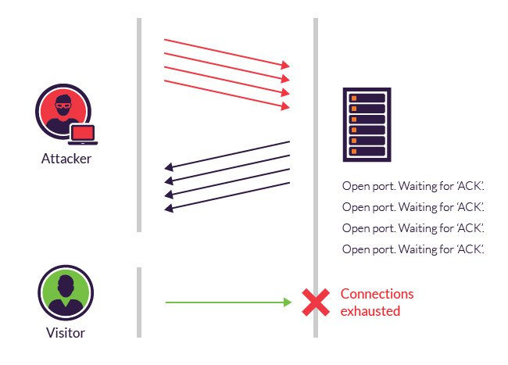
Packet Flooding (SYN Flood)
TCP connections start with a 3-step handshake: SYN → SYN-ACK → ACK.
In a SYN flood, the attacker sends thousands of SYN requests but never replies with the final ACK.
The server wastes memory and resources keeping these “half-open” connections alive.
Eventually, the server is so overloaded it can’t handle real requests.

Slide 9
Why it dangerous and how to solve it?
Why is this Dangerous?
Legitimate users (the real bakery customers) can’t connect — the service is effectively down.
It’s a type of Denial of Service (DoS) attack.
If done by many attackers at once, it becomes a Distributed Denial of Service (DDoS) attack.
How Do We Defend Against It?
SYN cookies → A trick where the server doesn’t reserve resources until the handshake is complete.
Firewalls & IDS/IPS → Detect and block suspicious flood traffic.
Rate limiting → Restrict how many new connections a single user can start.
Cloud DDoS protection → Offload bad traffic before it reaches the server.

Slide 10
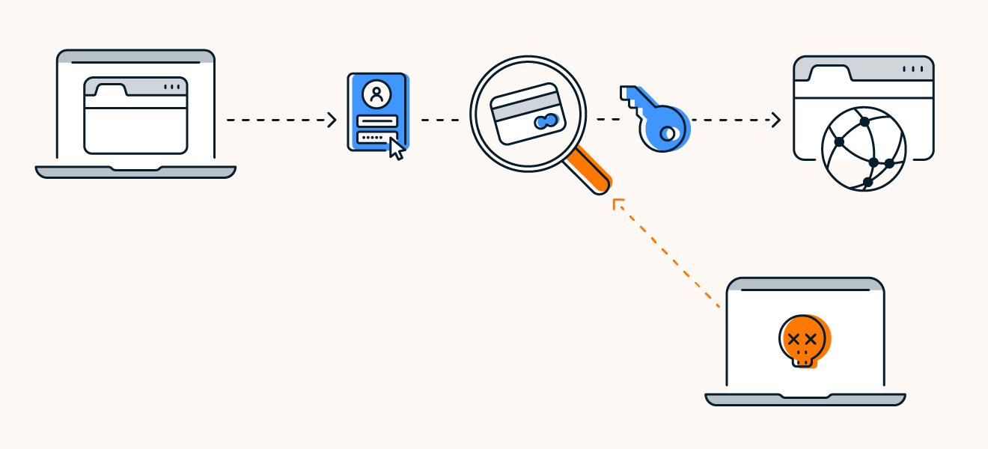
Packet Sniffing
On a network, information is sent in little chunks called packets.
These packets might contain:
usernames & passwords
emails
files
credit card numbers
A packet sniffer is a tool that captures these packets as they travel through the network.
If the data is not encrypted, the sniffer can read everything in plain text.

Slide 11
Why is it dangerous and how to solve it?
Why is This Dangerous?
Hackers can steal login credentials (like spying on you typing your password).
Sensitive information (emails, private messages, business data) can be exposed.
Attackers might also map the network to plan bigger attacks.
How Do We Defend Against It?
Encryption → If the letters are locked in envelopes (SSL/TLS, HTTPS, VPN), sniffers can’t read the contents.
Switched networks → Modern switches send packets only to the intended device (harder to sniff than old hubs).
Detection → Some intrusion detection systems can alert if sniffing is happening.
Safe practices → Always use HTTPS websites, VPNs, and avoid public Wi-Fi for sensitive work.

Slide 12
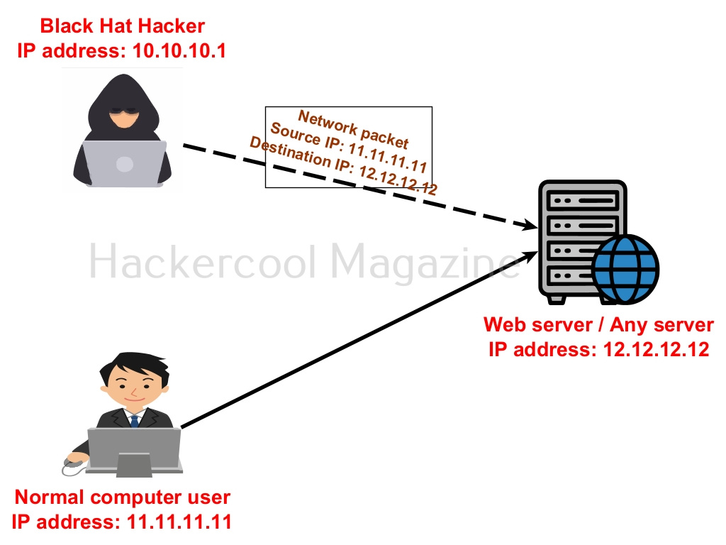
IP spoofing
Imagine someone sending you a letter pretending to be your bank. The return address looks real, but it’s fake. That’s IP spoofing: lying about where the message came from.

Slide 13
Why is it dangerous and how to solve it?
Why is This Dangerous?
Man-in-the-Middle → An attacker pretends to be a trusted system and intercepts communication.
Bypassing Security → Some systems trust certain IPs. If the attacker spoofs that IP, they might gain access.
DDoS Amplification → Attackers send requests with a victim’s IP as the return address. Servers then flood the victim with replies.
How Do We Defend Against It?
Ingress/Egress Filtering → Firewalls block packets with fake source addresses.
Authentication → Use digital certificates and encryption, not just IPs, to prove identity.
Monitoring → Intrusion detection systems can spot suspicious traffic patterns.
Avoid Blind Trust → Never rely only on IP addresses for identity.

Slide 14
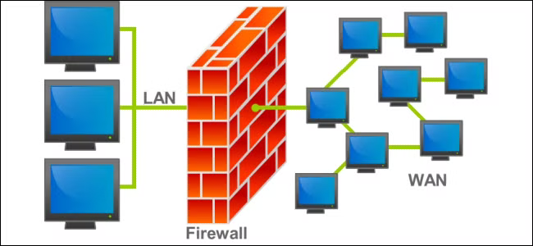
Firewalls
A firewall sits between your private network (your house) and the outside world (the internet).
It examines every packet (like each guest at the door).
Based on rules, it decides:
Allow the traffic (let them in).
Block the traffic (send them away).

Slide 15
Why is it important?
Why is This Important?
Without a firewall, it’s like leaving your doors wide open, anyone can walk in.
A firewall protects you from:
Hackers trying to sneak in
Viruses from suspicious downloads
Unwanted network traffic (spam, probes, scans)

Slide 16
Types of firewalls
Packet Filtering → Checks basic details (like checking an ID card at the door).
Stateful Firewall → Remembers conversations (like a bouncer who remembers you already came in).
Application Firewall → Examines behavior (like security asking why you’re entering the library).

Slide 17
Antivirus
Antivirus = a security program that looks for malicious software (viruses, worms, trojans, ransomware).
It scans your files, programs, and even downloads.
If it finds something dangerous, it:
Warns you
Blocks or deletes the file
Sometimes quarantines it (locks it away so it can’t spread)
How It Detects Threats
Behavioral detection
Heuristic analysis (Looks for unusual or suspicious code structures.)

Slide 18
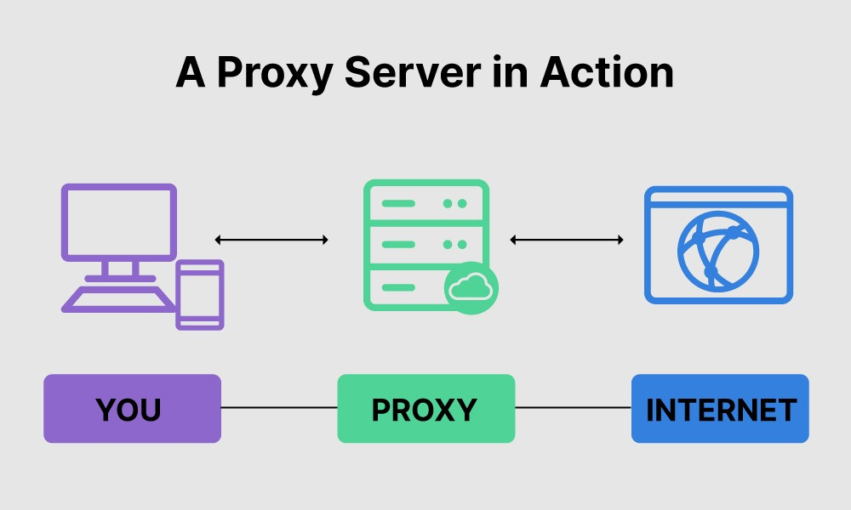
Proxy
A proxy server acts as an intermediary between a user and the internet.
Hides the user’s IP, filters content, caches requests, or enforces security policies.

Slide 19
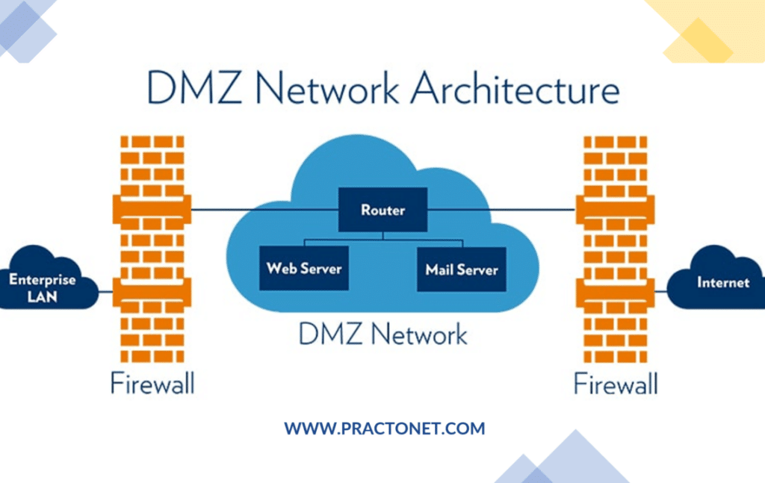
DMZ (De-militarized zone/perimeter network)
A DMZ is a buffer network between the internet (untrusted) and your internal network (trusted).
Public-facing servers (web, email, FTP) sit here, isolated from sensitive internal systems.

Slide 20
Management by Exception
Monitoring network and system activity, but only raising alerts for unusual events or anomalies.
Reduces alert fatigue and allows security teams to focus on real threats.
Examples:
A user logging in at 3:00 a.m. from a foreign country.
Sudden spikes in network traffic.
Access to files outside normal behavior patterns.

Slide 21
Retrofitting security
Retrofitting security = adding protections after a system is already built.
Can include firewalls, encryption, access controls, antivirus, or patching vulnerabilities.
Better than nothing, but proactive security design from the start is ideal.
Example :
A company builds a network or application without strong security features. Later, they face new threats or realize vulnerabilities exist. They add:
Firewalls
Antivirus software
Intrusion detection systems
Encryption

Slide 22
Advanced Persistent Threat (APT)
An APT is a long-term, targeted cyberattack.
Usually involves sophisticated hackers who infiltrate networks and remain undetected.
Goal: steal sensitive information, intellectual property, or monitor activity.

Slide 23
Targeted APT Attack
A targeted APT attack = hackers focusing on a specific organization.
Often involves custom malware, social engineering, and careful planning.
An attacker wants access to a specific company’s confidential designs.
Steps they might take:
Reconnaissance – research employees, emails, and systems.
Spear-phishing – send personalized emails to trick a key employee into opening malware.
Install malware that hides in the system for months.
Exfiltrate sensitive data slowly to avoid detection.
Unlike generic malware, this attack is highly customized and patient.

Slide 24
Third-Party Security
Third-party security = ensuring that partners, suppliers, or service providers don’t introduce vulnerabilities.
Many breaches happen through weak links in third-party systems.
A company has strong internal cybersecurity.
They work with third-party vendors, such as:
Cloud providers
Software developers
Payment processors
If a vendor is compromised or careless, attackers can use them as a gateway to the company’s network.
Example:
In 2013, Target was breached because hackers accessed Target’s network through a third-party HVAC vendor.

Slide 25
Social Engineering
Concept: Manipulating people into revealing confidential information.
Why it matters: Humans are often the weakest link in security.
Examples: Impersonation, baiting, pretexting.
Defense: Security awareness training, strict verification policies.

Slide 26
Phishing
Concept: Fake emails or websites trick users into giving credentials.
Why it matters: Common cause of breaches.
Defense: Anti-phishing filters, employee training.

Slide 27
Security Awareness
Concept: Training employees to recognize and prevent threats.
Why it matters: Prevents social engineering and human error.
Focus areas: Password hygiene, phishing recognition, reporting.

Slide 28
Security Assessment & Audit
Assessment: Identifies vulnerabilities before attackers do.
Audit: Checks compliance with standards and policies.
Why it matters: Ensures systems are secure and regulatory-compliant.

Slide 29
GRC (Governance, Risk, Compliance)
Governance: Leadership, roles, responsibilities.
Risk: Identifying and mitigating threats.
Compliance: Meeting regulatory/industry requirements.
Why it matters: Aligns business goals with security.

Slide 30
NIST(National Institute of Standards and Technology) Cybersecurity Framework
Core Functions: Identify, Protect, Detect, Respond, Recover.
Why it matters: Provides a structured approach to security.
Usage: Helps organizations assess and improve cybersecurity posture.

Slide 31
Maturity Model
Concept: Measures how advanced an organization’s cybersecurity is.
Levels: Initial → Repeatable → Defined → Managed → Optimizing.
Why it matters: Guides continuous improvement.

Slide 32
PCI-DSS (Payment Card Industry Data Security Standard)
Purpose: Protect cardholder data.
Requirements: Encryption, strong access control, monitoring.
Why it matters: Mandatory for businesses handling credit card data.

Slide 33
QSA (Qualified Security Assessor)
Role: Certified professional authorized to audit PCI-DSS compliance.
Why it matters: Ensures merchants follow payment security standards.

Slide 34
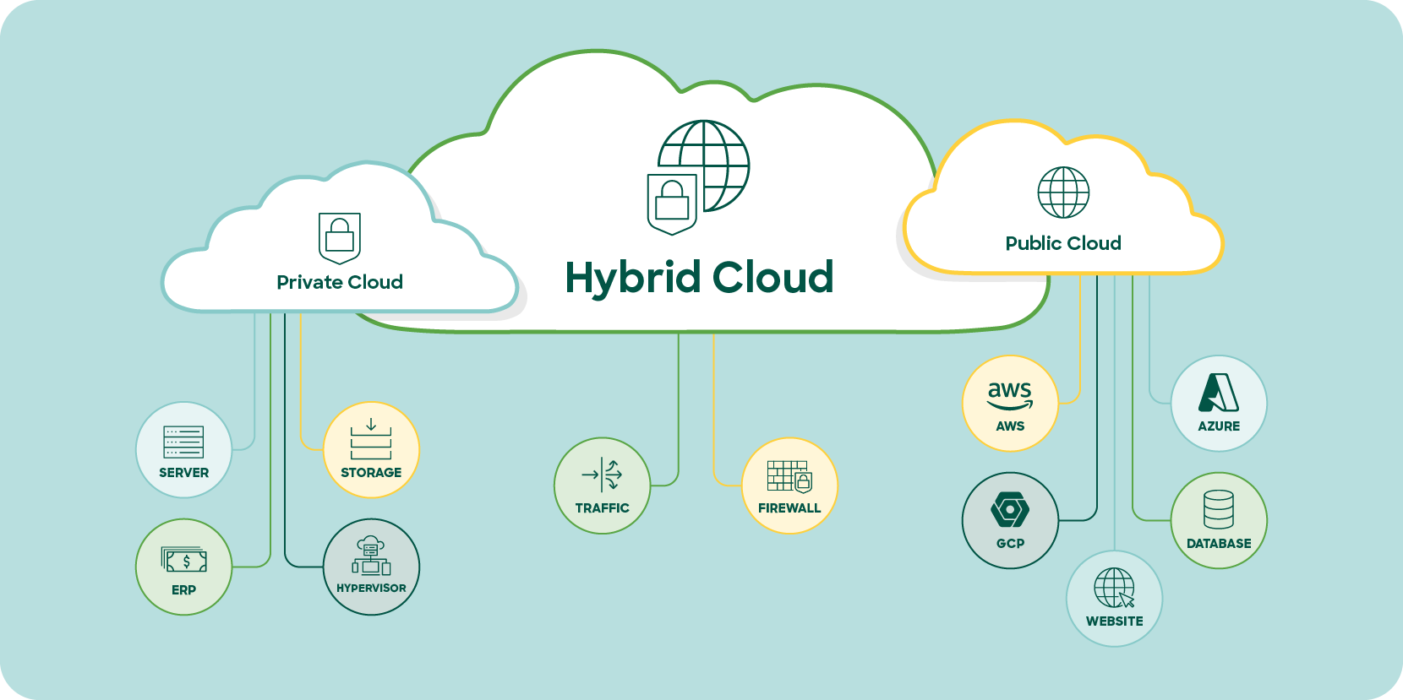
Hybrid Cloud Security
Hybrid Cloud = Combination of on-premises infrastructure (company data centers) + public cloud services (AWS, Azure, Google Cloud, etc.).Concept: Protecting workloads across on-premise + cloud.
Challenges: Data movement, visibility, identity management.
Defense: Zero Trust, encryption, CASB tools.

Slide 35
Enterprise Shift to Hybrid Cloud
Why Enterprises Shift to Hybrid Cloud
Flexibility → Run workloads where they make the most sense (on-prem for sensitive data, cloud for scalability).
Scalability → Burst into the cloud when extra capacity is needed.
Cost Efficiency → Pay-as-you-go cloud model while keeping legacy systems running internally.
Innovation → Access to AI, machine learning, and advanced analytics available only in the cloud.
Challenges
Expanded Attack Surface → Security must cover both on-prem and cloud.
Misconfigurations → Cloud misconfigurations are one of the top causes of breaches.
Data Movement → Data traveling between environments needs strong encryption.
Identity & Access Management → Ensuring consistent controls across multiple platforms.

Slide 36
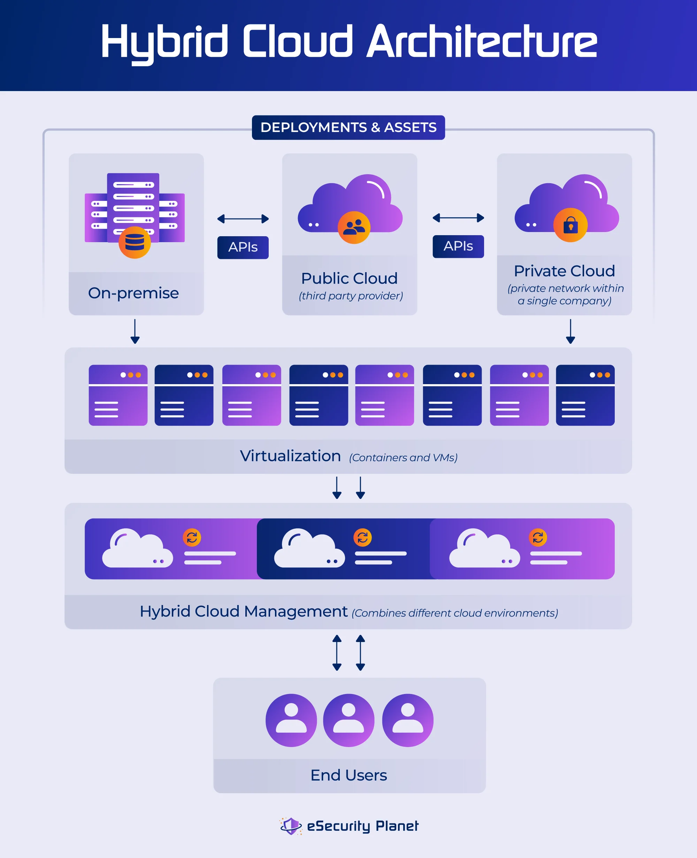
Advanced Hybrid Cloud Security Architecture
Components: Zero Trust, CASB, microsegmentation, encryption.
Goal: Unified protection across multi-cloud + on-prem.
Focus: Identity, workload, and data security.

Slide 37
Cloud Access Security Broker (CASB)
A CASB (Cloud Access Security Broker) is a security tool that sits between users and cloud services (like Google Workspace, Microsoft 365, Salesforce, etc.) to enforce security policies.
Think of it as a checkpoint for cloud traffic.
Visibility → See what cloud apps employees are using (shadow IT).
Access Control → Block or allow specific activities (e.g., prevent downloading sensitive data).
Data Protection → Encrypt or mask sensitive information before it goes to the cloud.
Threat Protection → Detect malware, risky logins, or compromised accounts.
Compliance → Enforce regulations like GDPR, HIPAA, PCI-DSS.
Microsoft Defender for Cloud Apps
Netskope
McAfee MVISION Cloud
Palo Alto Networks Prisma Cloud

Slide 38
Microsegmentation
Microsegmentation = Dividing a network into small, isolated zones (down to the workload or application level).
Breaks networks into isolated security zones at the application/workload level.
Prevents lateral movement after a breach.
Uses software-defined policies instead of just firewalls.
Benefits: Containment, compliance, visibility.
Challenges: Complexity, scaling across hybrid environments.

Slide 39
Security of Isolated Servers
Isolated = not connected to external networks.
Isolated server = a server deliberately kept off the main corporate network or internet (sometimes called air-gapped).
Protects critical data but still vulnerable to insiders & physical attacks.
Key defenses: Access control, removable media restrictions, air-gapping, encryption, physical security.

Slide 40
Outside Perimeters
Old model: firewalls protect the castle.
New reality: no single perimeter → users, devices, apps everywhere.
Security must focus on identity, endpoints, cloud, and Zero Trust(“Never trust, always verify.”)

Slide 41
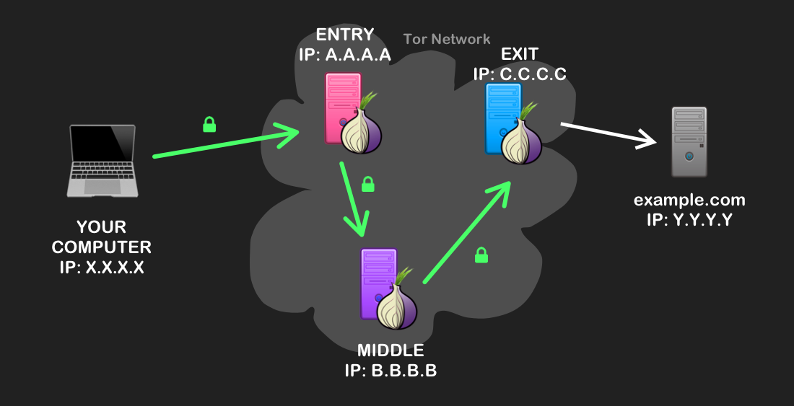
Onion routing and TOR
Onion Routing (Concept)
A method of sending internet traffic through multiple layers of encryption.
Each relay/node removes one layer of encryption (like peeling an onion) to reveal the next destination.
No single node knows both the sender and the final recipient.
2. TOR (The Onion Router)
A global network that implements onion routing.
Provides anonymity for users by hiding IP addresses and routes.
Anyone can use it via the TOR Browser.
Uses: Privacy, censorship evasion, but also crime.
Limitations: Slow, exit node risks, not 100% foolproof.

Slide 42
Cyber Attribution
Identifies who is behind an attack.
Challenges: Obfuscation(making something harder to understand or analyze by deliberately hiding its true meaning, structure, or purpose), false flags, anonymity tools.
Importance: Law enforcement, deterrence, national security.
Methods: Technical forensics + intelligence + behavioral analysis.

Slide 43
Critical Infrastructure Requirements & Protection
Definition: Essential systems vital for national security, economy, and public safety (e.g., energy, water, healthcare, transportation).
Key Requirements: Confidentiality, integrity, availability, resilience, compliance.
Protection Strategies: Network segmentation, access control, continuous monitoring, incident response planning, regular updates, employee training.

Slide 44
Mobility Security
Definition: Protecting mobile devices, applications, and data from cyber threats.
Key Risks: Malware, data leaks, device theft, insecure apps, unsecured Wi-Fi networks.
Security Measures:
Strong authentication (PINs, biometrics)
Device encryption
Mobile device management (MDM) solutions
Regular software updates and patching
Secure access to corporate networks (VPNs, zero trust)

Slide 45
Enterprise Mobile Device Management (MDM)
A security solution that helps organizations manage, monitor, and protect mobile devices (smartphones, tablets, laptops) used by employees.
Key Functions:
Device configuration and policy enforcement
App management and updates
Remote wipe or lock of lost/stolen devices
Security monitoring and threat detection
Data encryption and secure access to corporate resources

Slide 46
IMSI Catching
A technique used to intercept mobile device identifiers (IMSI – International Mobile Subscriber Identity) by simulating a cell tower.
Key Risks:
Eavesdropping on calls and messages
Tracking user location
Unauthorized access to mobile data
Protection Measures:
Use encrypted communication (e.g., VPNs, secure apps)
Keep devices updated with security patches
Avoid connecting to untrusted networks

Slide 47
IoT Security
Protecting Internet of Things (IoT) devices and networks from cyber threats.
Key Risks: Device hijacking, data breaches, weak authentication, insecure firmware, and botnet attacks.
Security Measures:
Strong passwords and authentication
Regular firmware and software updates
Network segmentation for IoT devices
Data encryption for communication
Continuous monitoring and threat detection

Slide 48
Using Deception & Honeypots for Security
Security techniques that use fake systems or data to lure attackers and study their methods.
Key Concepts:
Honeypots: Decoy systems designed to attract attackers.
Deception Technology: Creates fake assets, credentials, or network paths to mislead attackers.
Benefits:
Detects attacks early
Analyzes attacker behavior and tactics
Diverts attackers from real assets
Improves overall network security defenses

